Slide 1
Chapter 6 Arrays

Slide 2
Opening Problem
Read one hundred numbers, compute their average, and find out how many numbers are above the average.

Slide 3

Solution
AnalyzeNumbers

Slide 4
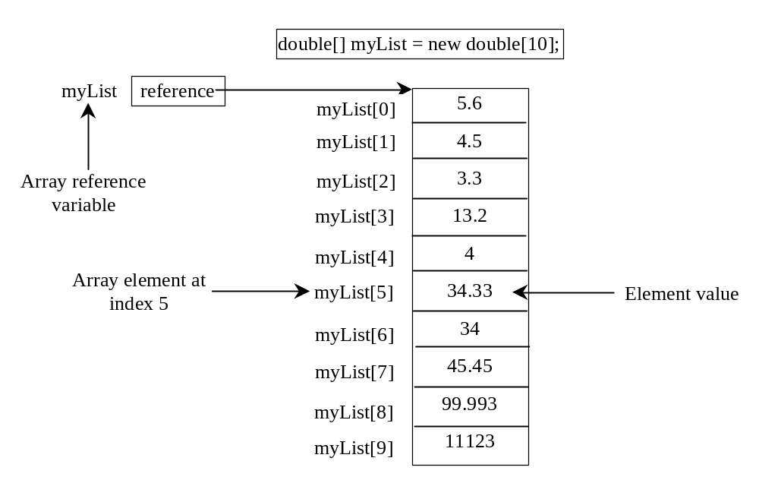
Introducing Arrays
Array is a data structure that represents a collection of the same types of data.

Slide 5
Declaring Array Variables
datatype[] arrayRefVar;
Example:
double[] myList;
datatype arrayRefVar[]; // This style is allowed, but not preferred
Example:
double myList[];

Slide 6
Creating Arrays
arrayRefVar = new datatype[arraySize];
Example:
myList = new double[10];
myList[0] references the first element in the array.
myList[9] references the last element in the array.

Slide 7
Declaring and Creating in One Step
datatype[] arrayRefVar = new
datatype[arraySize];
double[] myList = new double[10];
datatype arrayRefVar[] = new
datatype[arraySize];
double myList[] = new double[10];

Slide 8
The Length of an Array
Once an array is created, its size is fixed. It cannot be changed. You can find its size using
    arrayName.length
For example,
    myList.length returns 10

Slide 9
Default Values
When an array is created, its elements are assigned the default value of
  0 for the numeric primitive data types,
  '\u0000' for char types, and
  false for boolean types.

Slide 10
Indexed Variables
The array elements are accessed through the index. The array indices are 0-based, i.e., it starts from 0 to arrayRefVar.length-1. In the example in Figure 6.1, myList holds ten double values and the indices are from 0 to 9.
Each element in the array is represented using the following syntax, known as an indexed variable:
  arrayName[index];

Slide 11
Using Indexed Variables
After an array is created, an indexed variable can be used in the same way as a regular variable. For example, the following code adds the value in myList[0] and myList[1] to myList[2].
  myList[2] = myList[0] + myList[1];

Slide 12
Array Initializers
Declaring, creating, initializing in one step:
double[] myList = {1.9, 2.9, 3.4, 3.5};
This shorthand syntax must be in one statement.

Slide 13
Declaring, creating, initializing Using the Shorthand Notation
double[] myList = {1.9, 2.9, 3.4, 3.5};
This shorthand notation is equivalent to the following statements:
double[] myList = new double[4];
myList[0] = 1.9;
myList[1] = 2.9;
myList[2] = 3.4;
myList[3] = 3.5;

Slide 14
CAUTION
Using the shorthand notation, you have to declare, create, and initialize the array all in one statement. Splitting it would cause a syntax error. For example, the following is wrong:
  double[] myList;
  myList = {1.9, 2.9, 3.4, 3.5};

Slide 15
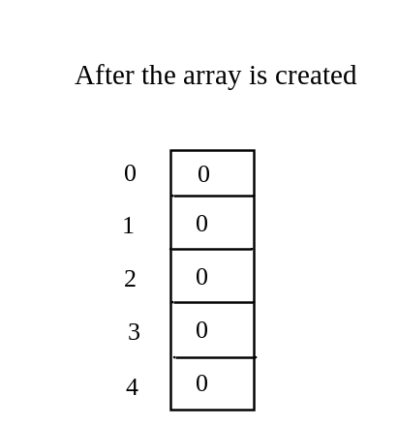
Trace Program with Arrays
animation
Declare array variable values, create an array, and assign its reference to values
public class Test {
public static void main(String[] args) {
int[] values = new int[5];
for (int i = 1; i < 5; i++) {
values[i] = i + values[i-1];
}
values[0] = values[1] + values[4];
}
}

Slide 16
Trace Program with Arrays
animation
i becomes 1
public class Test {
public static void main(String[] args) {
int[] values = new int[5];
for (int i = 1; i < 5; i++) {
values[i] = i + values[i-1];
}
values[0] = values[1] + values[4];
}
}

Slide 17
Trace Program with Arrays
animation
i (=1) is less than 5
public class Test {
public static void main(String[] args) {
int[] values = new int[5];
for (int i = 1; i < 5; i++) {
values[i] = i + values[i-1];
}
values[0] = values[1] + values[4];
}
}

Slide 18
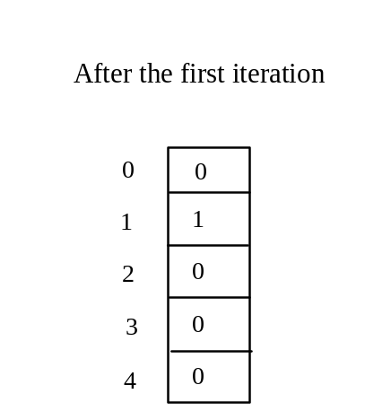
Trace Program with Arrays
animation
After this line is executed, value[1] is 1
public class Test {
public static void main(String[] args) {
int[] values = new int[5];
for (int i = 1; i < 5; i++) {
values[i] = i + values[i-1];
}
values[0] = values[1] + values[4];
}
}

Slide 19
Trace Program with Arrays
animation
After i++, i becomes 2
public class Test {
public static void main(String[] args) {
int[] values = new int[5];
for (int i = 1; i < 5; i++) {
values[i] = i + values[i-1];
}
values[0] = values[1] + values[4];
}
}

Slide 20
Trace Program with Arrays
animation
i (= 2) is less than 5
public class Test {
public static void main(String[] args) {
int[] values = new int[5];
for (int i = 1; i < 5; i++) {
values[i] = i + values[i-1];
}
values[0] = values[1] + values[4];
}
}

Slide 21
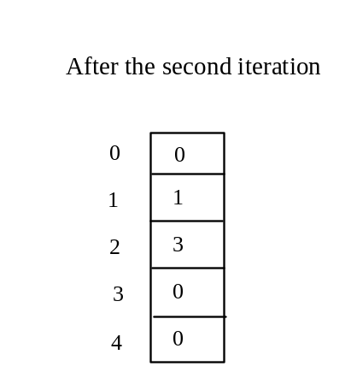
Trace Program with Arrays
animation
After this line is executed,
values[2] is 3 (2 + 1)
public class Test {
public static void main(String[] args) {
int[] values = new int[5];
for (int i = 1; i < 5; i++) {
values[i] = i + values[i-1];
}
values[0] = values[1] + values[4];
}
}

Slide 22
Trace Program with Arrays
animation
After this, i becomes 3.
public class Test {
public static void main(String[] args) {
int[] values = new int[5];
for (int i = 1; i < 5; i++) {
values[i] = i + values[i-1];
}
values[0] = values[1] + values[4];
}
}

Slide 23
Trace Program with Arrays
animation
i (=3) is still less than 5.
public class Test {
public static void main(String[] args) {
int[] values = new int[5];
for (int i = 1; i < 5; i++) {
values[i] = i + values[i-1];
}
values[0] = values[1] + values[4];
}
}

Slide 24
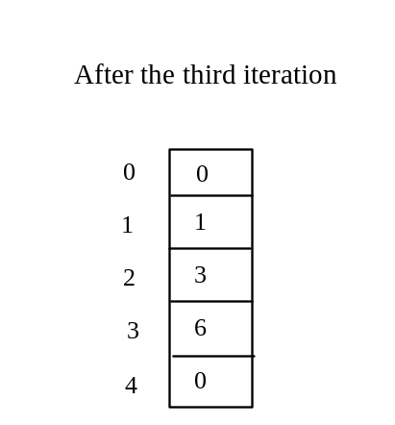
Trace Program with Arrays
animation
After this line, values[3] becomes 6 (3 + 3)
public class Test {
public static void main(String[] args) {
int[] values = new int[5];
for (int i = 1; i < 5; i++) {
values[i] = i + values[i-1];
}
values[0] = values[1] + values[4];
}
}

Slide 25

Trace Program with Arrays
animation
After this, i becomes 4
public class Test {
public static void main(String[] args) {
int[] values = new int[5];
for (int i = 1; i < 5; i++) {
values[i] = i + values[i-1];
}
values[0] = values[1] + values[4];
}
}

Slide 26
Trace Program with Arrays
animation
i (=4) is still less than 5
public class Test {
public static void main(String[] args) {
int[] values = new int[5];
for (int i = 1; i < 5; i++) {
values[i] = i + values[i-1];
}
values[0] = values[1] + values[4];
}
}

Slide 27
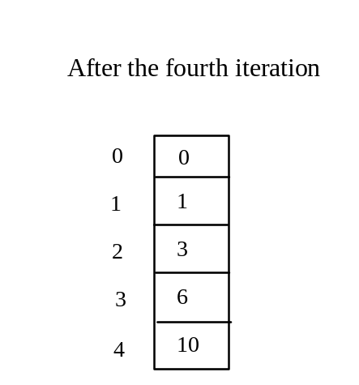
Trace Program with Arrays
animation
After this, values[4] becomes 10 (4 + 6)
public class Test {
public static void main(String[] args) {
int[] values = new int[5];
for (int i = 1; i < 5; i++) {
values[i] = i + values[i-1];
}
values[0] = values[1] + values[4];
}
}

Slide 28
Trace Program with Arrays
animation
After i++, i becomes 5
public class Test {
public static void main(String[] args) {
int[] values = new int[5];
for (int i = 1; i < 5; i++) {
values[i] = i + values[i-1];
}
values[0] = values[1] + values[4];
}
}

Slide 29
Trace Program with Arrays
animation
i ( =5) < 5 is false. Exit the loop
public class Test {
public static void main(String[] args) {
int[] values = new int[5];
for (int i = 1; i < 5; i++) {
values[i] = i + values[i-1];
}
values[0] = values[1] + values[4];
}
}

Slide 30
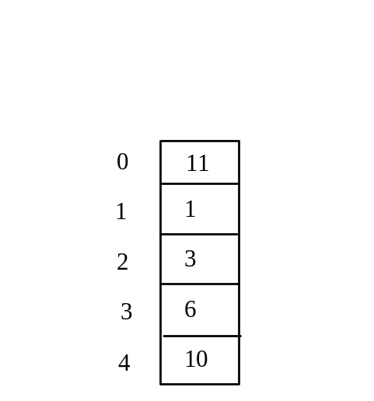
Trace Program with Arrays
animation
After this line, values[0] is 11 (1 + 10)
public class Test {
public static void main(String[] args) {
int[] values = new int[5];
for (int i = 1; i < 5; i++) {
values[i] = i + values[i-1];
}
values[0] = values[1] + values[4];
}
}

Slide 31
Processing Arrays
See the examples in the text.
(Initializing arrays with input values)
(Initializing arrays with random values)
(Printing arrays)
(Summing all elements)
(Finding the largest element)
(Finding the smallest index of the largest element)
(Shifting elements)

Slide 32
Initializing arrays with input values
java.util.Scanner input = new java.util.Scanner(System.in);
System.out.print("Enter " + myList.length + " values: ");
for (int i = 0; i < myList.length; i++)
myList[i] = input.nextDouble();

Slide 33
Initializing arrays with random values
for (int i = 0; i < myList.length; i++) {
myList[i] = Math.random() * 100;
}

Slide 34
Printing arrays
for (int i = 0; i < myList.length; i++) {
System.out.print(myList[i] + " ");
}

Slide 35
Summing all elements
double total = 0;
for (int i = 0; i < myList.length; i++) {
total += myList[i];
}

Slide 36
Finding the largest element
double max = myList[0];
for (int i = 1; i < myList.length; i++) {
if (myList[i] > max)
max = myList[i];
}

Slide 37
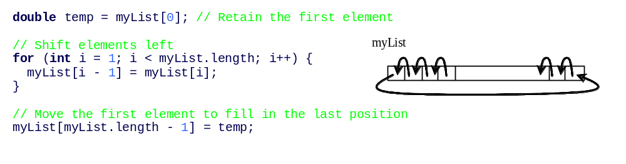
Shifting Elements

Slide 38
Enhanced for Loop (for-each loop)
JDK 1.5 introduced a new for loop that enables you to traverse the complete array sequentially without using an index variable. For example, the following code displays all elements in the array myList:
  for (double value: myList)
  System.out.println(value);
In general, the syntax is
  for (elementType value: arrayRefVar) {
  // Process the value
  }
You still have to use an index variable if you wish to traverse the array in a different order or change the elements in the array.

Slide 39
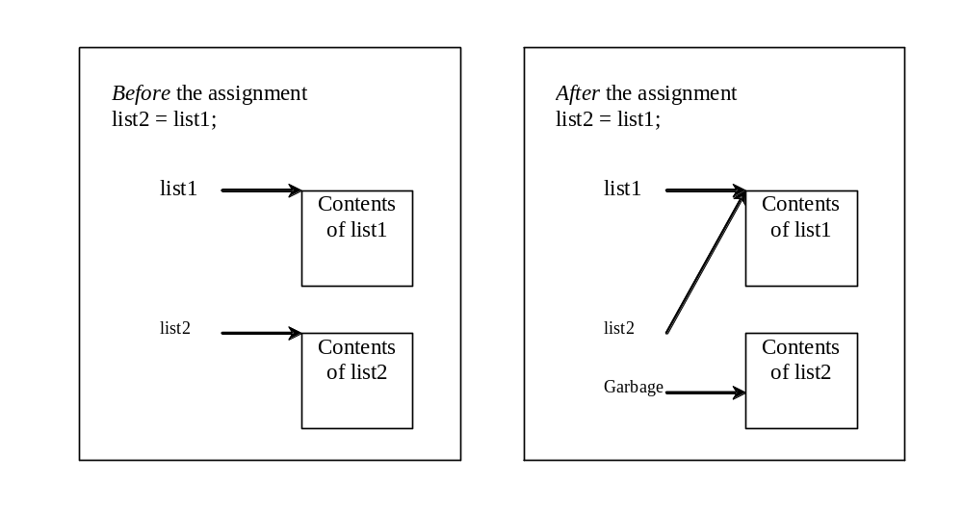
Copying Arrays
Often, in a program, you need to duplicate an array or a part of an array. In such cases you could attempt to use the assignment statement (=), as follows:
list2 = list1;

Slide 40
Copying Arrays
Using a loop:
int[] sourceArray = {2, 3, 1, 5, 10};
int[] targetArray = new int[sourceArray.length];
for (int i = 0; i < sourceArrays.length; i++)
targetArray[i] = sourceArray[i];

Slide 41
The arraycopy Utility
arraycopy(sourceArray, src_pos, targetArray, tar_pos, length);
Example:
System.arraycopy(sourceArray, 0, targetArray, 0, sourceArray.length);

Slide 42
Passing Arrays to Methods
public static void printArray(int[] array) {
for (int i = 0; i < array.length; i++) {
System.out.print(array[i] + " ");
}
}
Invoke the method
int[] list = {3, 1, 2, 6, 4, 2};
printArray(list);
Invoke the method
printArray(new int[]{3, 1, 2, 6, 4, 2});
Anonymous array

Slide 43
Anonymous Array
  The statement
    printArray(new int[]{3, 1, 2, 6, 4, 2});
  creates an array using the following syntax:
    new dataType[]{literal0, literal1, ..., literalk};
  There is no explicit reference variable for the array. Such array is called an anonymous array.

Slide 44
Pass By Value
Java uses pass by value to pass arguments to a method. There are important differences between passing a value of variables of primitive data types and passing arrays.
For a parameter of a primitive type value, the actual value is passed. Changing the value of the local parameter inside the method does not affect the value of the variable outside the method.
For a parameter of an array type, the value of the parameter contains a reference to an array; this reference is passed to the method. Any changes to the array that occur inside the method body will affect the original array that was passed as the argument.

Slide 45
Simple Example
public class Test {
public static void main(String[] args) {
int x = 1; // x represents an int value
int[] y = new int[10]; // y represents an array of int values
m(x, y); // Invoke m with arguments x and y
System.out.println("x is " + x);
System.out.println("y[0] is " + y[0]);
}
public static void m(int number, int[] numbers) {
number = 1001; // Assign a new value to number
numbers[0] = 5555; // Assign a new value to numbers[0]
}
}

Slide 46
Passing Arrays as Arguments
Objective: Demonstrate differences of passing primitive data type variables and array variables.
TestPassArray
Run

Slide 47
Returning an Array from a Method
public static int[] reverse(int[] list) {
int[] result = new int[list.length];
for (int i = 0, j = result.length - 1;
i < list.length; i++, j--) {
result[j] = list[i];
}
return result;
}
list
result
int[] list1 = new int[]{1, 2, 3, 4, 5, 6};
int[] list2 = reverse(list1);

Slide 48
Trace the reverse Method
animation
int[] list1 = {1, 2, 3, 4, 5, 6};
int[] list2 = reverse(list1);
Declare result and create array
public static int[] reverse(int[] list) {
int[] result = new int[list.length];
for (int i = 0, j = result.length - 1;
i < list.length; i++, j--) {
result[j] = list[i];
}
return result;
}
list
1
2
3
4
5
6
result
0
0
0
0
0
0

Slide 49
Trace the reverse Method, cont.
animation
int[] list1 = new int[]{1, 2, 3, 4, 5, 6};
int[] list2 = reverse(list1);
i = 0 and j = 5
public static int[] reverse(int[] list) {
int[] result = new int[list.length];
for (int i = 0, j = result.length - 1;
i < list.length; i++, j--) {
result[j] = list[i];
}
return result;
}
list
1
2
3
4
5
6
result
0
0
0
0
0
0

Slide 50
Trace the reverse Method, cont.
animation
int[] list1 = new int[]{1, 2, 3, 4, 5, 6};
int[] list2 = reverse(list1);
i (= 0) is less than 6
public static int[] reverse(int[] list) {
int[] result = new int[list.length];
for (int i = 0, j = result.length - 1;
i < list.length; i++, j--) {
result[j] = list[i];
}
return result;
}
list
1
2
3
4
5
6
result
0
0
0
0
0
0

Slide 51
Trace the reverse Method, cont.
animation
int[] list1 = new int[]{1, 2, 3, 4, 5, 6};
int[] list2 = reverse(list1);
i = 0 and j = 5
Assign list[0] to result[5]
public static int[] reverse(int[] list) {
int[] result = new int[list.length];
for (int i = 0, j = result.length - 1;
i < list.length; i++, j--) {
result[j] = list[i];
}
return result;
}
list
1
2
3
4
5
6
result
0
0
0
0
0
1

Slide 52
Trace the reverse Method, cont.
animation
int[] list1 = new int[]{1, 2, 3, 4, 5, 6};
int[] list2 = reverse(list1);
After this, i becomes 1 and j becomes 4
public static int[] reverse(int[] list) {
int[] result = new int[list.length];
for (int i = 0, j = result.length - 1;
i < list.length; i++, j--) {
result[j] = list[i];
}
return result;
}
list
1
2
3
4
5
6
result
0
0
0
0
0
1

Slide 53
Trace the reverse Method, cont.
animation
int[] list1 = new int[]{1, 2, 3, 4, 5, 6};
int[] list2 = reverse(list1);
i (=1) is less than 6
public static int[] reverse(int[] list) {
int[] result = new int[list.length];
for (int i = 0, j = result.length - 1;
i < list.length; i++, j--) {
result[j] = list[i];
}
return result;
}
list
1
2
3
4
5
6
result
0
0
0
0
0
1

Slide 54
Trace the reverse Method, cont.
animation
int[] list1 = new int[]{1, 2, 3, 4, 5, 6};
int[] list2 = reverse(list1);
i = 1 and j = 4
Assign list[1] to result[4]
public static int[] reverse(int[] list) {
int[] result = new int[list.length];
for (int i = 0, j = result.length - 1;
i < list.length; i++, j--) {
result[j] = list[i];
}
return result;
}
list
1
2
3
4
5
6
result
0
0
0
0
2
1

Slide 55
Trace the reverse Method, cont.
animation
int[] list1 = new int[]{1, 2, 3, 4, 5, 6};
int[] list2 = reverse(list1);
After this, i becomes 2 and j becomes 3
public static int[] reverse(int[] list) {
int[] result = new int[list.length];
for (int i = 0, j = result.length - 1;
i < list.length; i++, j--) {
result[j] = list[i];
}
return result;
}
list
1
2
3
4
5
6
result
0
0
0
0
2
1

Slide 56
Trace the reverse Method, cont.
animation
int[] list1 = new int[]{1, 2, 3, 4, 5, 6};
int[] list2 = reverse(list1);
i (=2) is still less than 6
public static int[] reverse(int[] list) {
int[] result = new int[list.length];
for (int i = 0, j = result.length - 1;
i < list.length; i++, j--) {
result[j] = list[i];
}
return result;
}
list
1
2
3
4
5
6
result
0
0
0
0
2
1

Slide 57
Trace the reverse Method, cont.
animation
int[] list1 = new int[]{1, 2, 3, 4, 5, 6};
int[] list2 = reverse(list1);
i = 2 and j = 3
Assign list[i] to result[j]
public static int[] reverse(int[] list) {
int[] result = new int[list.length];
for (int i = 0, j = result.length - 1;
i < list.length; i++, j--) {
result[j] = list[i];
}
return result;
}
list
1
2
3
4
5
6
result
0
0
0
3
2
1

Slide 58
Trace the reverse Method, cont.
animation
int[] list1 = new int[]{1, 2, 3, 4, 5, 6};
int[] list2 = reverse(list1);
After this, i becomes 3 and j becomes 2
public static int[] reverse(int[] list) {
int[] result = new int[list.length];
for (int i = 0, j = result.length - 1;
i < list.length; i++, j--) {
result[j] = list[i];
}
return result;
}
list
1
2
3
4
5
6
result
0
0
0
3
2
1

Slide 59
Trace the reverse Method, cont.
animation
int[] list1 = new int[]{1, 2, 3, 4, 5, 6};
int[] list2 = reverse(list1);
i (=3) is still less than 6
public static int[] reverse(int[] list) {
int[] result = new int[list.length];
for (int i = 0, j = result.length - 1;
i < list.length; i++, j--) {
result[j] = list[i];
}
return result;
}
list
1
2
3
4
5
6
result
0
0
0
3
2
1

Slide 60
Trace the reverse Method, cont.
animation
int[] list1 = new int[]{1, 2, 3, 4, 5, 6};
int[] list2 = reverse(list1);
i = 3 and j = 2
Assign list[i] to result[j]
public static int[] reverse(int[] list) {
int[] result = new int[list.length];
for (int i = 0, j = result.length - 1;
i < list.length; i++, j--) {
result[j] = list[i];
}
return result;
}
list
1
2
3
4
5
6
result
0
0
4
3
2
1

Slide 61
Trace the reverse Method, cont.
animation
int[] list1 = new int[]{1, 2, 3, 4, 5, 6};
int[] list2 = reverse(list1);
After this, i becomes 4 and j becomes 1
public static int[] reverse(int[] list) {
int[] result = new int[list.length];
for (int i = 0, j = result.length - 1;
i < list.length; i++, j--) {
result[j] = list[i];
}
return result;
}
list
1
2
3
4
5
6
result
0
0
4
3
2
1

Slide 62
Trace the reverse Method, cont.
animation
int[] list1 = new int[]{1, 2, 3, 4, 5, 6};
int[] list2 = reverse(list1);
i (=4) is still less than 6
public static int[] reverse(int[] list) {
int[] result = new int[list.length];
for (int i = 0, j = result.length - 1;
i < list.length; i++, j--) {
result[j] = list[i];
}
return result;
}
list
1
2
3
4
5
6
result
0
0
4
3
2
1

Slide 63
Trace the reverse Method, cont.
animation
int[] list1 = new int[]{1, 2, 3, 4, 5, 6};
int[] list2 = reverse(list1);
i = 4 and j = 1
Assign list[i] to result[j]
public static int[] reverse(int[] list) {
int[] result = new int[list.length];
for (int i = 0, j = result.length - 1;
i < list.length; i++, j--) {
result[j] = list[i];
}
return result;
}
list
1
2
3
4
5
6
result
0
5
4
3
2
1

Slide 64
Trace the reverse Method, cont.
animation
int[] list1 = new int[]{1, 2, 3, 4, 5, 6};
int[] list2 = reverse(list1);
After this, i becomes 5 and j becomes 0
public static int[] reverse(int[] list) {
int[] result = new int[list.length];
for (int i = 0, j = result.length - 1;
i < list.length; i++, j--) {
result[j] = list[i];
}
return result;
}
list
1
2
3
4
5
6
result
0
5
4
3
2
1

Slide 65
Trace the reverse Method, cont.
animation
int[] list1 = new int[]{1, 2, 3, 4, 5, 6};
int[] list2 = reverse(list1);
i (=5) is still less than 6
public static int[] reverse(int[] list) {
int[] result = new int[list.length];
for (int i = 0, j = result.length - 1;
i < list.length; i++, j--) {
result[j] = list[i];
}
return result;
}
list
1
2
3
4
5
6
result
0
5
4
3
2
1

Slide 66
Trace the reverse Method, cont.
animation
int[] list1 = new int[]{1, 2, 3, 4, 5, 6};
int[] list2 = reverse(list1);
i = 5 and j = 0
Assign list[i] to result[j]
public static int[] reverse(int[] list) {
int[] result = new int[list.length];
for (int i = 0, j = result.length - 1;
i < list.length; i++, j--) {
result[j] = list[i];
}
return result;
}
list
1
2
3
4
5
6
result
6
5
4
3
2
1

Slide 67
Trace the reverse Method, cont.
animation
int[] list1 = new int[]{1, 2, 3, 4, 5, 6};
int[] list2 = reverse(list1);
After this, i becomes 6 and j becomes -1
public static int[] reverse(int[] list) {
int[] result = new int[list.length];
for (int i = 0, j = result.length - 1;
i < list.length; i++, j--) {
result[j] = list[i];
}
return result;
}
list
1
2
3
4
5
6
result
6
5
4
3
2
1

Slide 68
Trace the reverse Method, cont.
animation
int[] list1 = new int[]{1, 2, 3, 4, 5, 6};
int[] list2 = reverse(list1);
i (=6) < 6 is false. So exit the loop.
public static int[] reverse(int[] list) {
int[] result = new int[list.length];
for (int i = 0, j = result.length - 1;
i < list.length; i++, j--) {
result[j] = list[i];
}
return result;
}
list
1
2
3
4
5
6
result
6
5
4
3
2
1

Slide 69
Trace the reverse Method, cont.
animation
int[] list1 = new int[]{1, 2, 3, 4, 5, 6};
int[] list2 = reverse(list1);
Return result
public static int[] reverse(int[] list) {
int[] result = new int[list.length];
for (int i = 0, j = result.length - 1;
i < list.length; i++, j--) {
result[j] = list[i];
}
return result;
}
list
1
2
3
4
5
6
list2
result
6
5
4
3
2
1

Slide 70
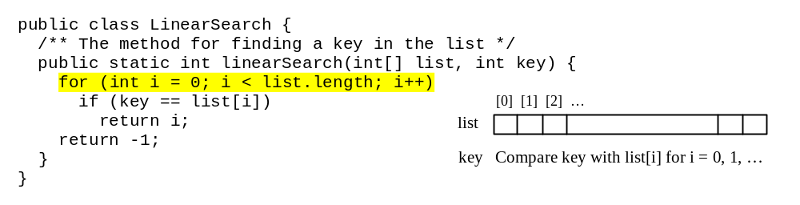
Searching Arrays
Searching is the process of looking for a specific element in an array; for example, discovering whether a certain score is included in a list of scores. Searching is a common task in computer programming. There are many algorithms and data structures devoted to searching.

Slide 71
Linear Search
The linear search approach compares the key element, key, sequentially with each element in the array list. The method continues to do so until the key matches an element in the list or the list is exhausted without a match being found. If a match is made, the linear search returns the index of the element in the array that matches the key. If no match is found, the search returns -1.

Slide 72
Linear Search Animation
animation
Key
List
3
6 | 4 | 1 | 9 | 7 | 3 | 2 | 8
3
6 | 4 | 1 | 9 | 7 | 3 | 2 | 8
3
6 | 4 | 1 | 9 | 7 | 3 | 2 | 8
3
6 | 4 | 1 | 9 | 7 | 3 | 2 | 8
3
6 | 4 | 1 | 9 | 7 | 3 | 2 | 8
3
6 | 4 | 1 | 9 | 7 | 3 | 2 | 8

Slide 73
From Idea to Solution
/** The method for finding a key in the list */
public static int linearSearch(int[] list, int key) {
for (int i = 0; i < list.length; i++)
if (key == list[i])
return i;
return -1;
}
Trace the method
int[] list = {1, 4, 4, 2, 5, -3, 6, 2};
int i = linearSearch(list, 4); // returns 1
int j = linearSearch(list, -4); // returns -1
int k = linearSearch(list, -3); // returns 5

Slide 74
Sorting Arrays
Sorting, like searching, is also a common task in computer programming. Many different algorithms have been developed for sorting.

Slide 75
The Arrays.sort Method
Since sorting is frequently used in programming, Java provides several overloaded sort methods for sorting an array of int, double, char, short, long, and float in the java.util.Arrays class. For example, the following code sorts an array of numbers and an array of characters.
  double[] numbers = {6.0, 4.4, 1.9, 2.9, 3.4, 3.5};
  java.util.Arrays.sort(numbers);
  char[] chars = {'a', 'A', '4', 'F', 'D', 'P'};
  java.util.Arrays.sort(chars);

